Slide 1
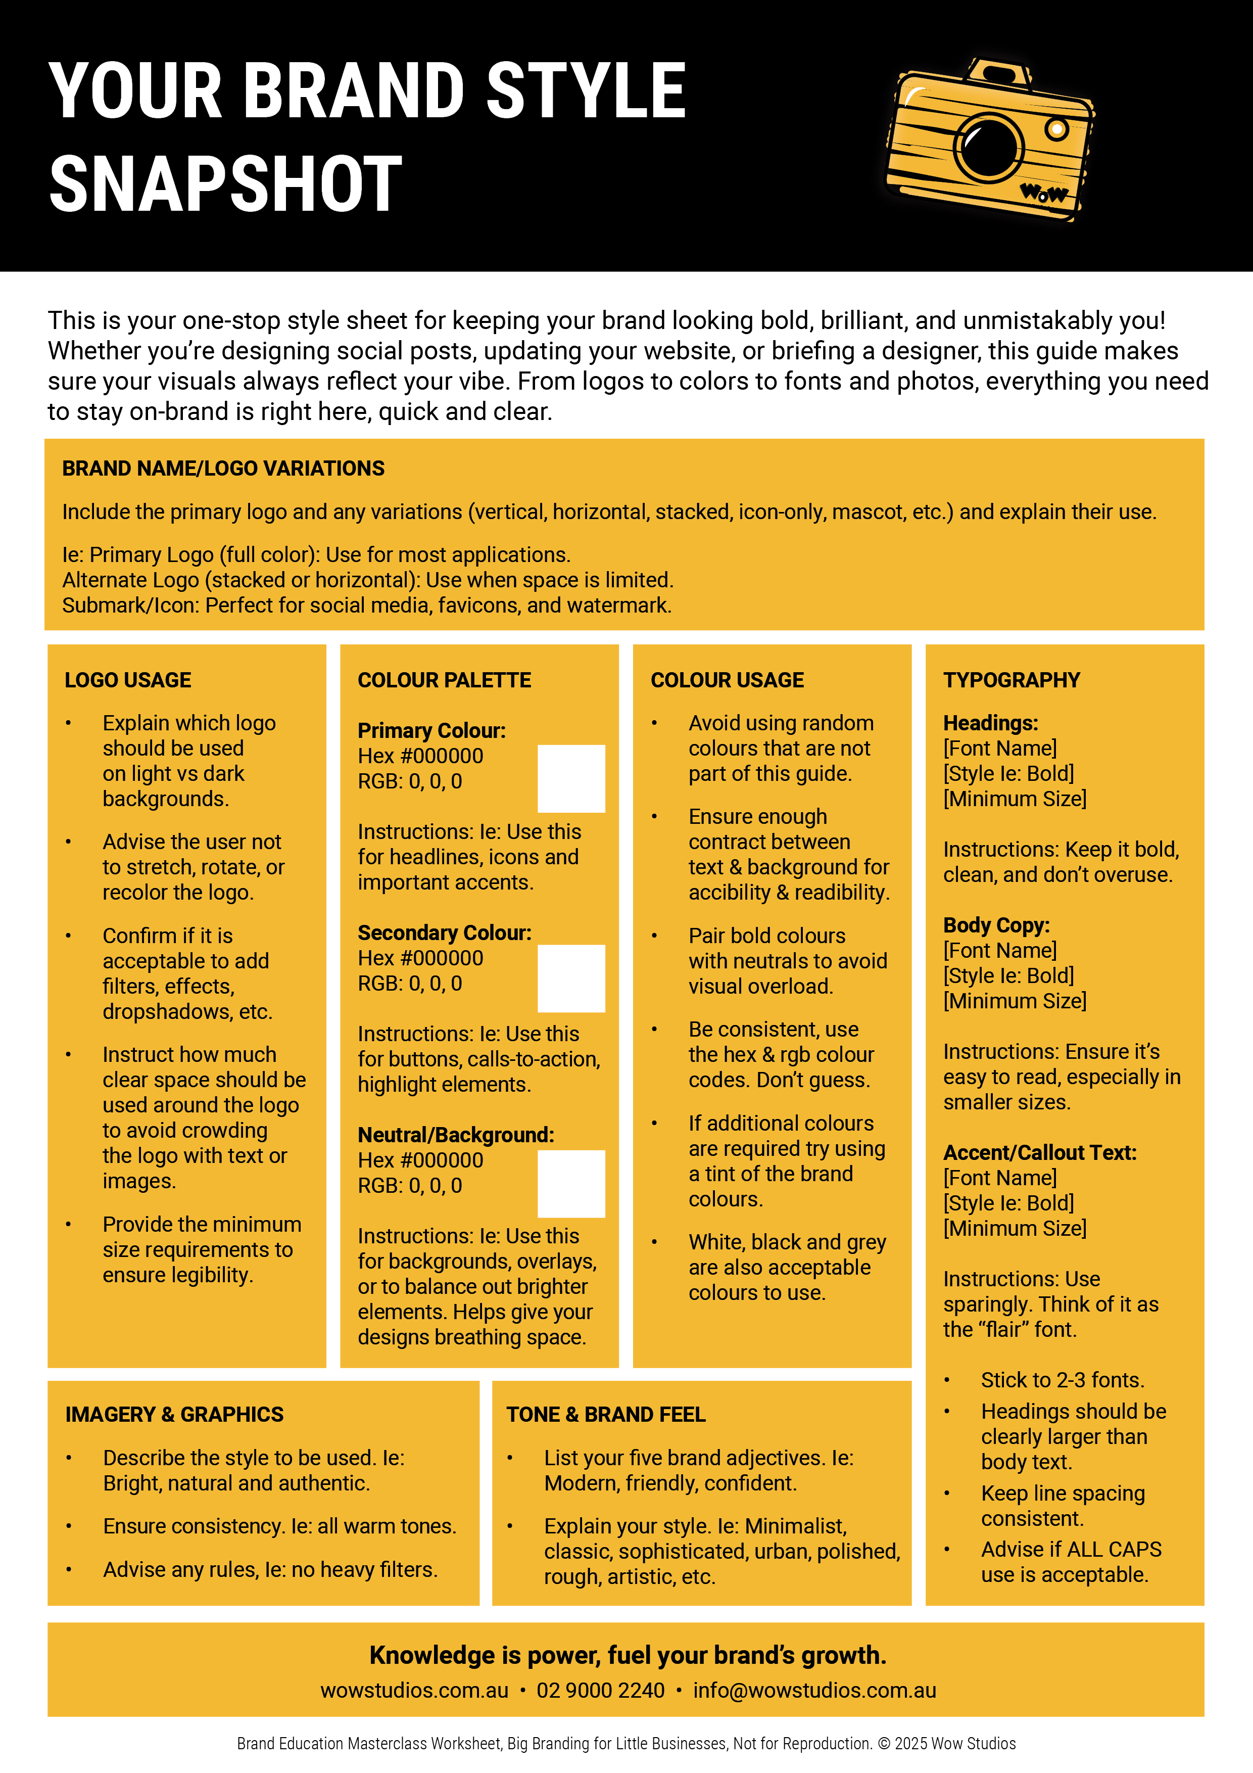

Slide 2


BRAND NAME/LOGO VARIATIONS
Primary Logo
Secondary Logo
Submark/Icon
Other
LOGO USAGE
COLOUR PALETTE
Primary Colour:
Hex #
RGB:
Instructions:
COLOUR USAGE
TYPOGRAPHY
Headings:
[Font Name]
[Style Ie: Bold]
[Minimum Size]
Instructions:
Secondary Colour:
Hex #
RGB:
Instructions:
Body Copy:
[Font Name]
[Style Ie: Bold]
[Minimum Size]
Instructions:
Neutral/Background:
Hex #
RGB:
Instructions:
Accent/Callout Text:
[Font Name]
[Style Ie: Bold]
[Minimum Size]
Instructions:
IMAGERY & GRAPHICS
TONE & BRAND FEEL

